Slide 1
การตรวจราชการกรณีปกติ ระดับกระทรวงสาธารณสุข
รอบที่ 1 ประจำปีงบประมาณ 2566
จังหวัดเพชรบูรณ์
วันที่ 22-24 มีนาคม 2566
Notes:
Thank you for Downloading our item form Premast Plus
-------------------------------
You must attribute the graphics to plus.premast.com :
In order to use a content or a part of it, you must attribute it to plus.premast.com ,
so we will be able to continue creating new free PowerPoint graphic resources every day.
You are free to use this item:
- For both personal and commercial projects and to modify it.
- In a website or presentation template or as part of your design.
You are not allowed to:
- Sub-license, resell or rent it.
- Include it in any online or offline archive or database.

Slide 3
กำหนดการตรวจราชการกรณีปกติ ระดับกระทรวงสาธารณสุข รอบที่ ๑ ปีงบประมาณ ๒๕๖๖ จังหวัดเพชรบูรณ์ วันที่ ๒๒ – ๒๔ มีนาคม ๒๕๖๖
Notes:
Thank you for Downloading our item form Premast Plus
-------------------------------
You must attribute the graphics to plus.premast.com :
In order to use a content or a part of it, you must attribute it to plus.premast.com ,
so we will be able to continue creating new free PowerPoint graphic resources every day.
You are free to use this item:
- For both personal and commercial projects and to modify it.
- In a website or presentation template or as part of your design.
You are not allowed to:
- Sub-license, resell or rent it.
- Include it in any online or offline archive or database.

Slide 4
Notes:
Thank you for Downloading our item form Premast Plus
-------------------------------
You must attribute the graphics to plus.premast.com :
In order to use a content or a part of it, you must attribute it to plus.premast.com ,
so we will be able to continue creating new free PowerPoint graphic resources every day.
You are free to use this item:
- For both personal and commercial projects and to modify it.
- In a website or presentation template or as part of your design.
You are not allowed to:
- Sub-license, resell or rent it.
- Include it in any online or offline archive or database.

Slide 5
Notes:
Thank you for Downloading our item form Premast Plus
-------------------------------
You must attribute the graphics to plus.premast.com :
In order to use a content or a part of it, you must attribute it to plus.premast.com ,
so we will be able to continue creating new free PowerPoint graphic resources every day.
You are free to use this item:
- For both personal and commercial projects and to modify it.
- In a website or presentation template or as part of your design.
You are not allowed to:
- Sub-license, resell or rent it.
- Include it in any online or offline archive or database.

Slide 6
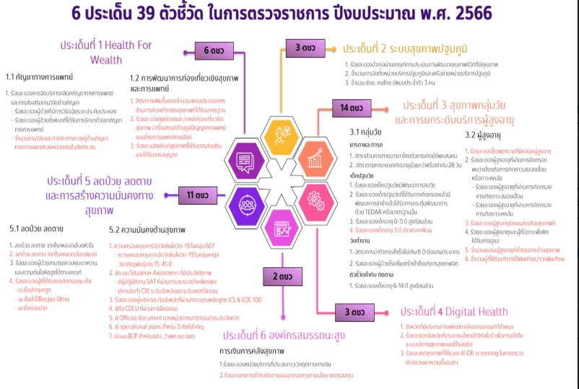
Notes:
Thank you for Downloading our item form Premast Plus
-------------------------------
You must attribute the graphics to plus.premast.com :
In order to use a content or a part of it, you must attribute it to plus.premast.com ,
so we will be able to continue creating new free PowerPoint graphic resources every day.
You are free to use this item:
- For both personal and commercial projects and to modify it.
- In a website or presentation template or as part of your design.
You are not allowed to:
- Sub-license, resell or rent it.
- Include it in any online or offline archive or database.

Slide 7
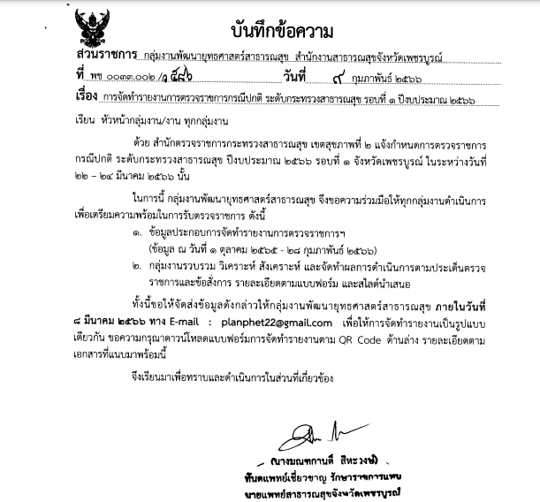

Slide 8
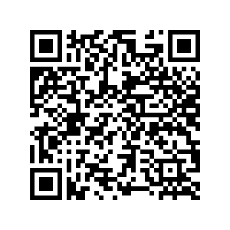
เอกสารประกอบการตรวจราชการ ปีงบประมาณ 2566
Notes:
Thank you for Downloading our item form Premast Plus
-------------------------------
You must attribute the graphics to plus.premast.com :
In order to use a content or a part of it, you must attribute it to plus.premast.com ,
so we will be able to continue creating new free PowerPoint graphic resources every day.
You are free to use this item:
- For both personal and commercial projects and to modify it.
- In a website or presentation template or as part of your design.
You are not allowed to:
- Sub-license, resell or rent it.
- Include it in any online or offline archive or database.

